Slide 1



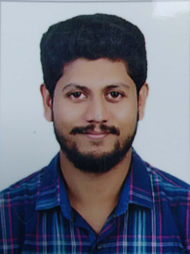



Linux L3 | 10 years | CAGIP UNIX
Hi, I am
Kiran
Thomas J
Worked as Project Coordinator, Team Lead & Linux L3 Admin.
Have worked in Government Owned Datacentres & supported 55000+ Servers till now
Interested in Automation, AI & CI-CD Delivery.
EXPERIENCE
PEPS Program for SILCA & I3
SKILLS AND COMPETENCIES
Project Management
Problem Management
Application Support Management
Service Management
Transition Management
Your Photo here
GRADE
C2
LANGUAGES
English, Malayalam
LOCATION
Bangalore, INDIA
CERTIFICATIONS
RHCE in RHEL 6
RHCSA in RHEL 8
CCNA – Routing & Switching
Social Miles
https://in.linkedin.com/in/kiran-thomas-j-77971540 # CSR Initiator
# Team Builder
# Inspiring Leader
# Top Performer
ACCOLADES
Best Data Center Auditor
TCS, 2016
Best Performer in Project
HCL, 2020

